Slide 1
MICROSOFT TEAMS
Assignments on Teams
For teachers pupils and parents/carers

Slide 2
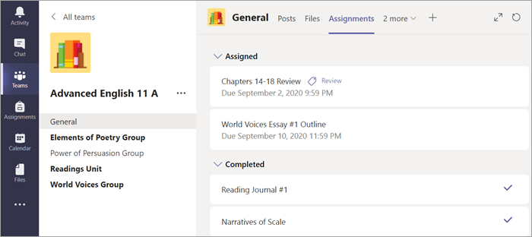
WHAT IS AN ASSIGNMENT?
An assignment is the area where pupils access tasks/resources set by teachers
Click on your Class Channel in the desired classroom, then select Assignments.
This is where the work you need to complete can by found
The work will have a completion date or ‘turn in’ date
Your Assigned work will show in order of the date they need completing.
Click on any assignment to open it and view the assignment’s details.
Tip: Select the Expansion icon (diagonal, double sided arrow) to work in full-screen mode.

Slide 3
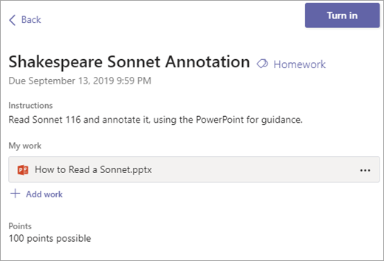
‘TURN IN’ AN ASSIGNMENT
‘Turn in’ means - hand in. When you have completed an assignment, you need to Turn it in and upload it onto your specific class Teams area so your teacher can mark it
Attaching files:
Your teachers can also see whether you have accessed (looked and opened it) on your class Teams area.
Make sure you complete the work set and more importantly - TURN IT IN!
Your teacher will set work which you need to ‘turn in’.
Your teacher will have set a date you need to ‘turn it in’ by.
You can also attach other files. Select +Add work and upload your work

Slide 4
‘TURN IN’ AN ASSIGNMENT
Select the Turn in button to hand in an assignment.
The button will change depending on the status:
‘Turn in again’ if you’re editing an assignment you’ve already turned in and need to submit work again.
‘Turn in late’ if you’re turning in your assignment after the due date, but your teacher has allowed late turn-ins or asked for an improvement.
‘Not turned in’ if the assignment is late and your teacher is no longer accepting turn-ins. You cannot turn in work.
‘Undo turn in’ if you decide you want to edit your assignment before the due date. You'll need to turn it in again after you make your edits

Slide 5
VIEW YOUR ASSIGNMENTS
Assignments you haven't turned in yet will by listed by order of due date under the Assigned arrow.
Select Load previous and Load more to see which assignments you have. Assignments you haven't opened yet will have a bold title.
Late assignments will include a Past due warning.
Select an assignment to attach any work and turn it in.
Upcoming Assignments:
Assignment title and due date: This will be highlighted before the turn in date.
Past due: This means you haven’t turned your assignment in yet and it’s past the ‘turn in’ date. This will only appear if your teacher is accepting late turn-ins.

